Slide 1

Supporting the development of strategies for business and communities
Chris Kolek
10 July 2019

Slide 2

20 Years Ago
Market Towns…
‘play a critical role in helping rural communities to thrive and in regenerating deprived areas’
‘provide an important commercial and leisure focus for a rural hinterland, especially in areas that have suffered from the decline of agriculture, mining, textiles or other industries’
Rural White Paper, November 2000.

Slide 3
Drivers of change in 2000
Increasing centralisation of services to larger towns and cities
Growing competition from edge-of-town and out-of-town supermarkets and retail parks
Emergence of internet-based services as a potential threat to traditional high street services

Slide 4
Vision for market towns
A focus for economic development and regeneration;
A centre meeting people’s needs for access to a wide range of retail, professional and public services;
A focus for properly planned and coordinated public transport;
Distinctive places to live with potential to be centres of cultural activity.
Rural White Paper, November 2000

Slide 5
Market Towns Initiative - positives
Evaluations identified:
Increased partnership working
Additional investment in the towns
Building increased community capacity
Improvements in effectiveness of governance
Improvements in project delivery
Community engagement in the planning

Slide 6
Market Towns Initiative - negatives
Evaluations identified:
Strong dependence on central and local government funding
Some reluctancy from businesses to engage
Some requirements criticised as being overly prescriptive
Short-term nature of the funding and difficulty identifying suitable succession strategies
Lacking strategic importance and impact

Slide 7
Drivers of change in 2010
Financial crisis has a profound impact including:
Reduced public spending affects services and investment in towns
Squeezed household budgets affect consumer spending in the towns
Shops and businesses in towns close as competition from discounters and online retailers continues to grow

Slide 8
Portas Review 2011
28 recommendations including:
Need ‘Town Teams’
Make business rates work better for business
Make it easier to change use of key properties
Disincentives to landlords who leave properties empty
Inclusion of the high street in Neighbourhood Plans
Run a number of ‘High Street Pilots’

Slide 9
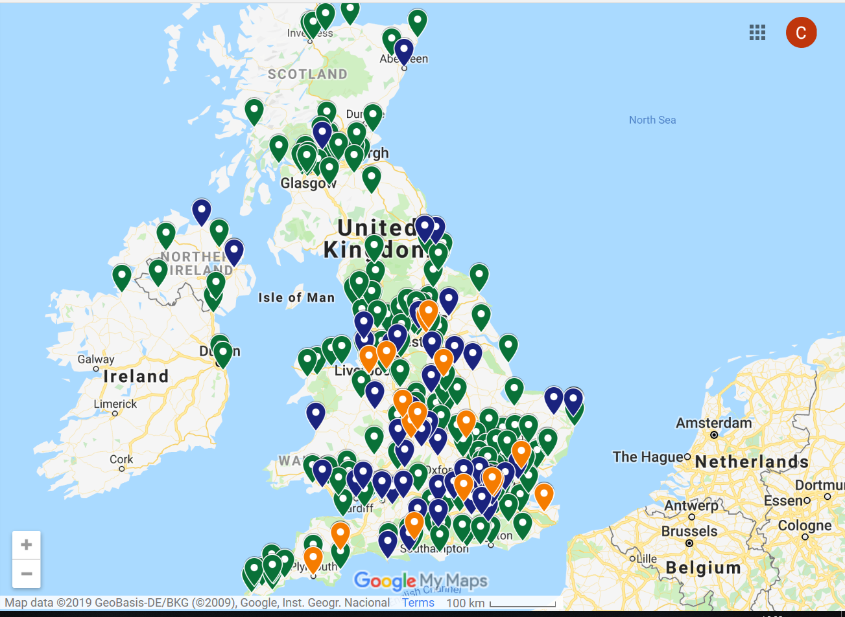
Business Improvement Districts
Over 300 BIDs established in UK and rising by about 25 per year.

Slide 10
Compulsory v voluntary
Compulsory | Voluntary
Certainty of budget helps project planning | Financial contributions are by choice only
Not dependent on government funding | Normally less controversial
Most businesses have financial stake in its success | Greater freedom to change its priorities
Underpinned by democratic mandate | Often engage a wider area and community
Accountable at ballot box | May need to be more innovative to survive
BUT… | BUT…
Contentious due to the compulsory levy | Greater requirement for external funding
No opt out for levy payers | Fewer businesses will have a financial stake in it
Governance could be better regulated | Usually only accountable to its membership

Slide 11
Conclusions
After 20 years of initiatives we are still learning how to get the best from our towns.
Our towns need investment from both the public and private sectors.
There is no single model approach, as each has its own pros and cons.
But in all cases, towns can be more effective if they receive the right support and work together.

