Slide 1
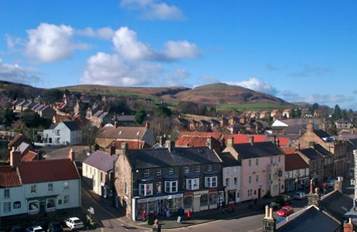
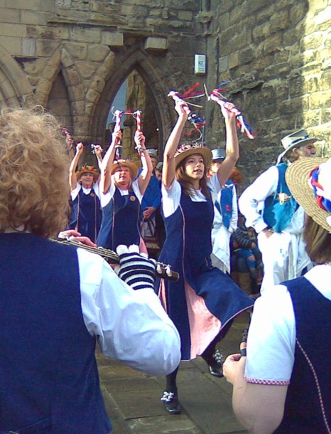
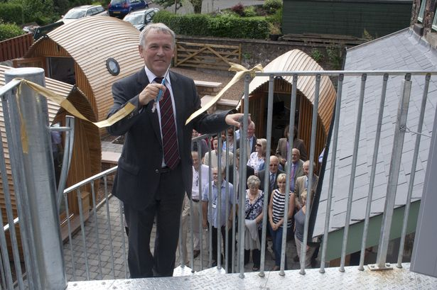
ILG Seminar, Beaumont Hotel, Hexham, 10th July 2019
Strengthening the wellbeing of market towns in the rural north and borderlands
Professor Mark Shucksmith OBE,
Newcastle University and Carnegie UK Trustee

Slide 2

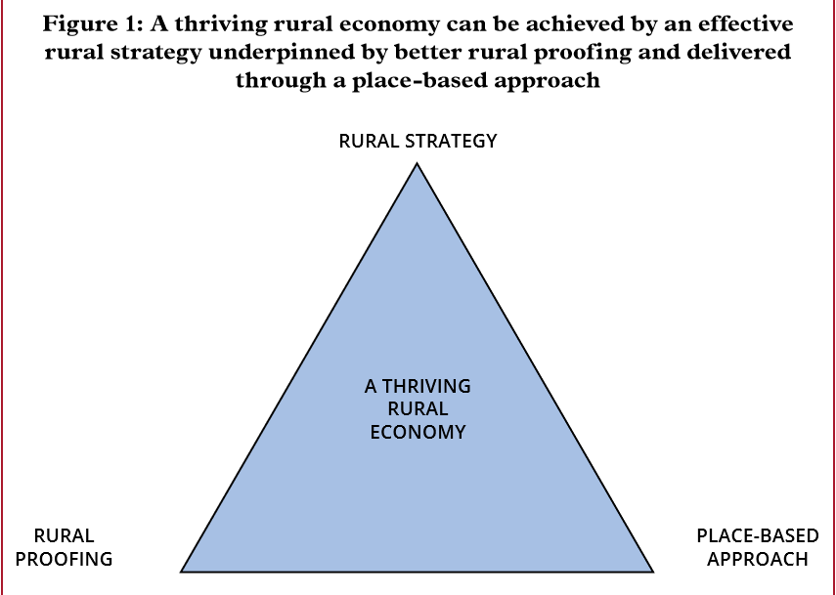
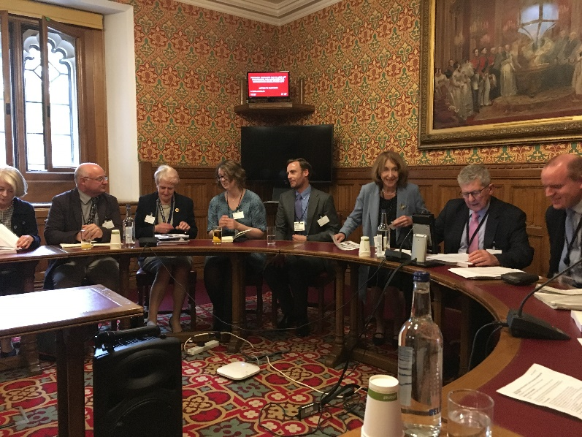
House of Lords Select Committee on Rural Economy, May 2019
Key Recommendations:
A thriving rural economy requires
Coherent Rural Strategy
Re-energized rural proofing
Place-based approach
Targeted recommendations:
Local industrial strategies and LEPs
Local action and capacity-building
Post-Brexit funding streams
Digital connectivity
Housing and planning
Skills and business support
Delivering essential services

Slide 3

Academic perspectives
(Dr Neil Powe, Newcastle University)
Many examples of successful small town revival rely on amenity-based strategies (landscape/heritage/culture). Powe asks if non-amenity based small town revival is also possible.
The principal ingredients found by Powe are:
A place-based approach: combination of national policy and local endeavour.
Supporting existing businesses to grow rather than attracting external firms. Most rural businesses are set up by people with personal connections to the town. And existing businesses tend to be better embedded and adapted.
Consider how the town’s proposed strategy fits with others’ strategies and with residents’ imaginations of their place. Amenity-led revival activity may have less resonance to those who see their place as a ‘working town’.
Given the unfavourable national political context, local leaders must create a business-friendly environment – business space, networks, infrastructure, etc. Residential desirability, place loyalty and belonging are key assets.
Better lobbying for external support for a place-based approach is essential.
https://www.routledge.com/Planning-for-Small-Town-Change/Powe-Hart/p/book/9781138025660
https://www.sciencedirect.com/science/article/pii/S0743016718301001?via%3Dihub

Slide 4


Slide 5


Slide 6
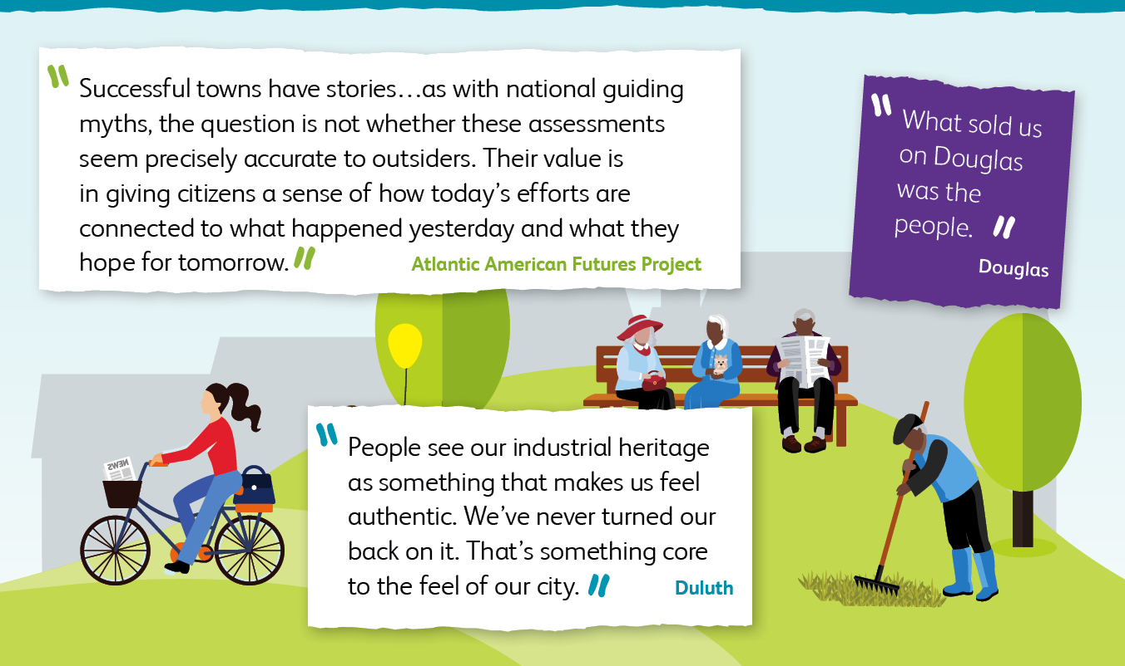

Slide 7


Slide 8

https://www.carnegieuktrust.org.uk/theme/flourishing-towns/ Pippa@carnegieuk.org

