Slide 1
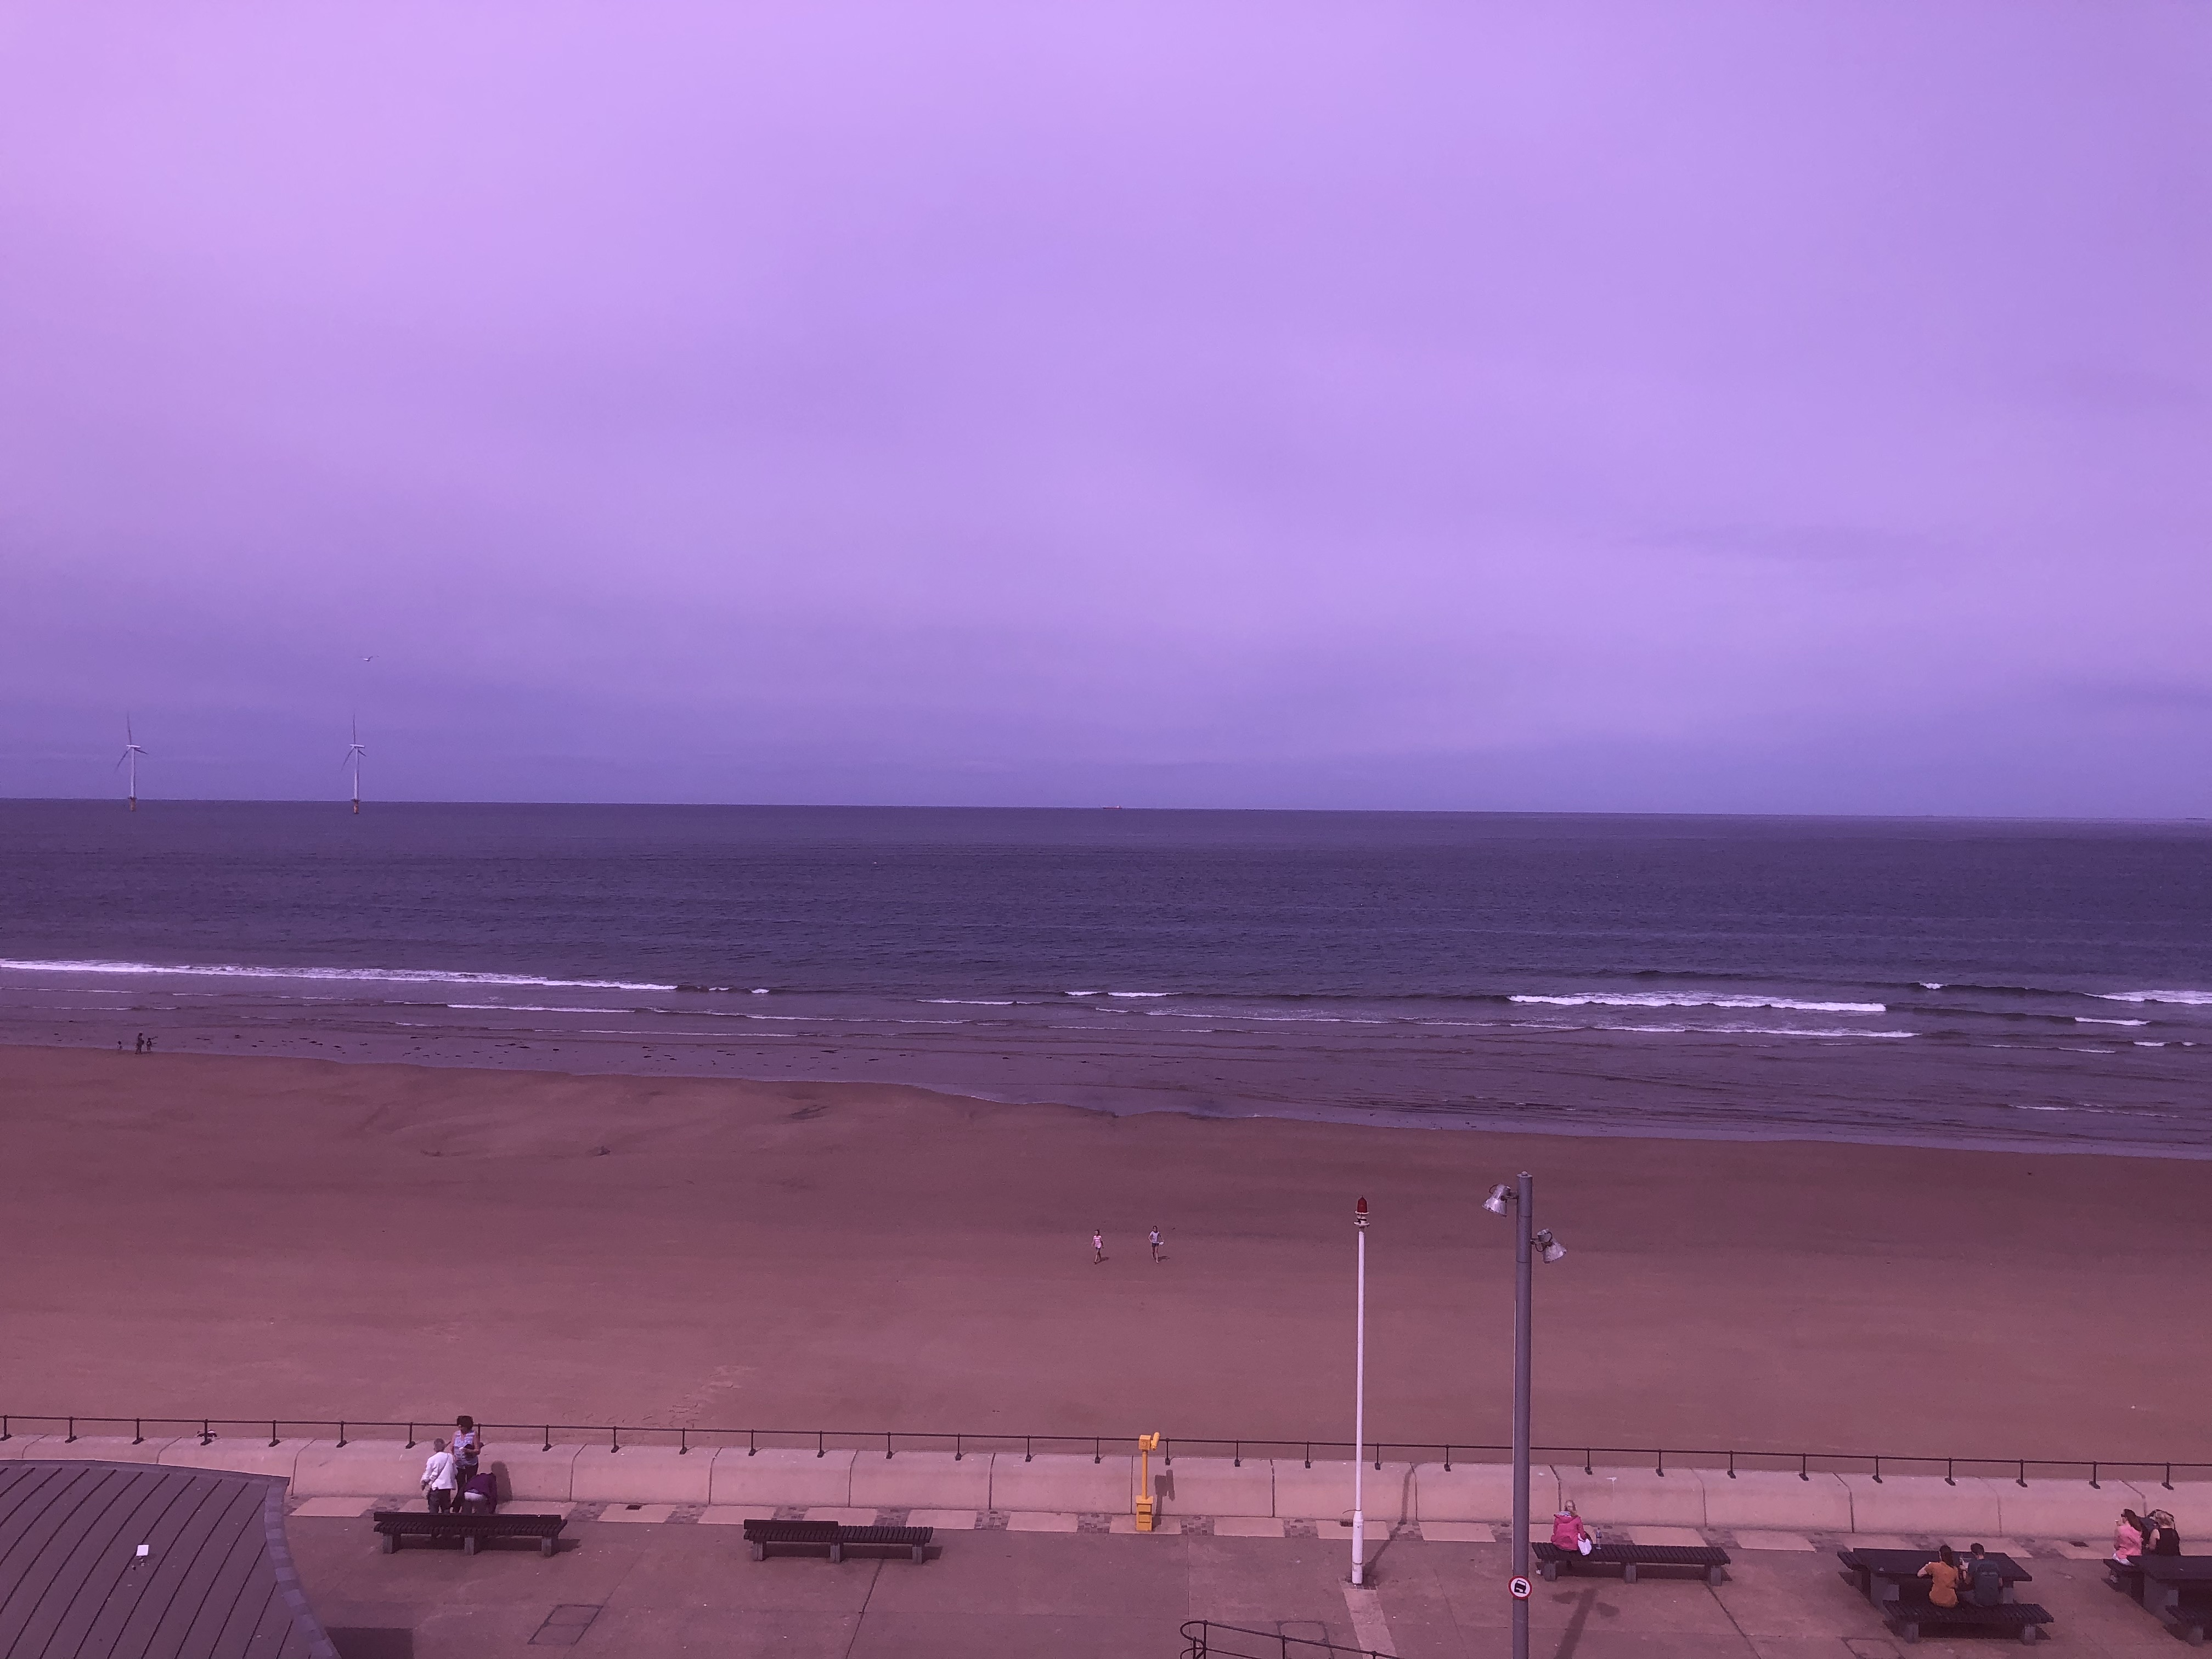

The future of Civil Society
A View From Redcar & Cleveland

Slide 2

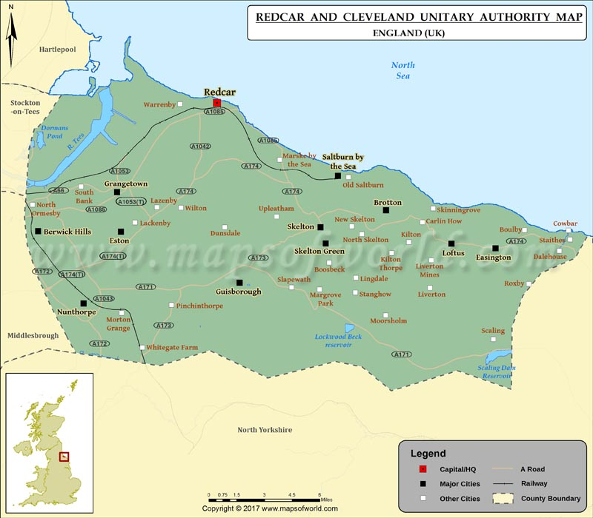
Redcar & Cleveland
Population 136,000
Area 96 sq miles
Established 1974
Fastest Ageing Borough in Tees Valley

Slide 3
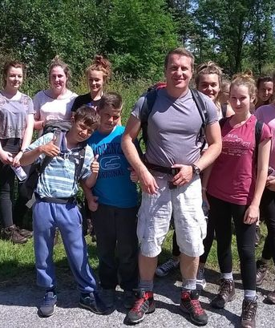
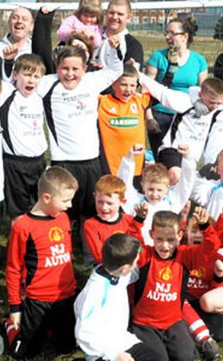
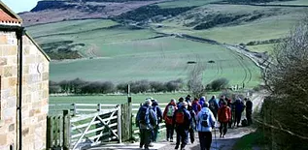

Current Position
Eclectic mix:
Small & Medium sized Charites
Disproportionate number CIC’s
Constituted Groups
Clubs & Societies
Informal activity
Your company name

Slide 4
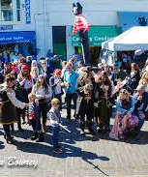
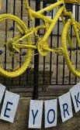
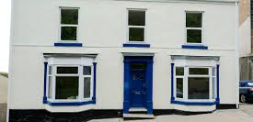
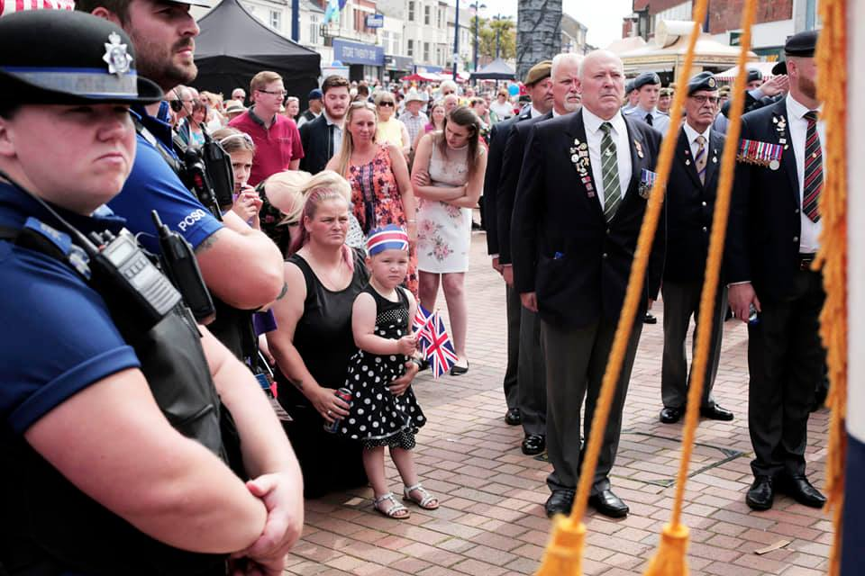
The Future
Sport England & City of Culture
Increased grass roots activism
Assets, Assets, Assets!!
Collaboration
Rehabilitation for Grants
Contracting and Social Finance where appropriate
Your company name

Slide 5
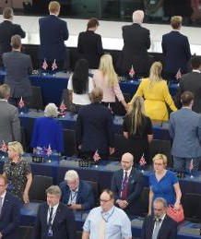
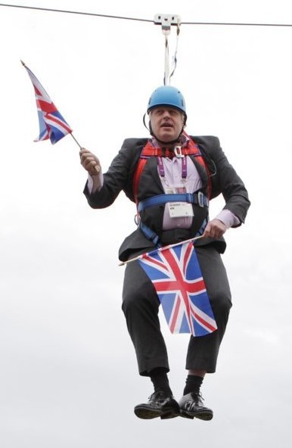
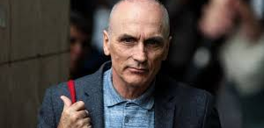
Glass half Full?
Political Disruption
Tees Valley Combined Authority
Increasing Local Authority support
Youth and the spirit of ‘68
What is the alternative?

