Slide 1
Contribution of small business to social wellbeing and civil society

Slide 2
Who are we
As experts in business, we offer our members a wide range of vital business services including advice, financial expertise, support and a powerful voice in government. Our mission is to help smaller businesses achieve their ambitions.
Established 45 years ago to help our members succeed in business, we are a non-profit making and non-party political organisation that’s led by our members, for our members.
4000 members across the North East of England

Slide 3
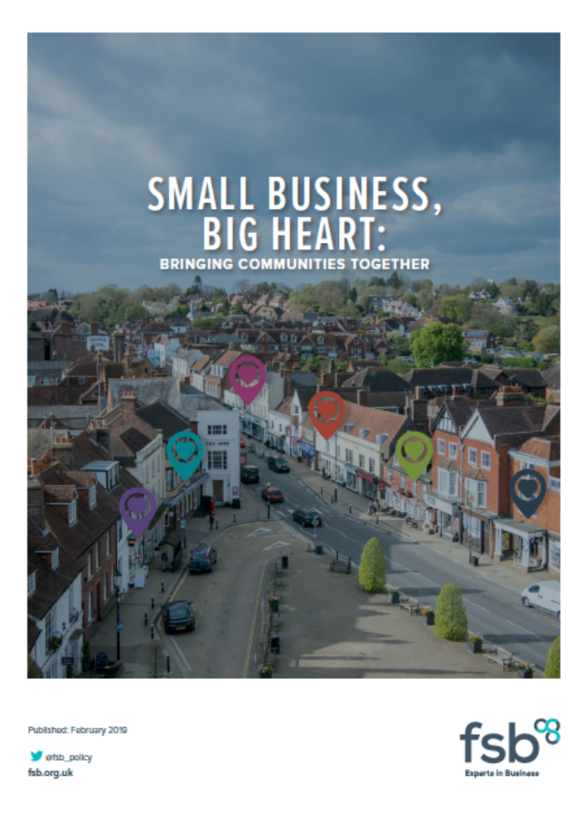
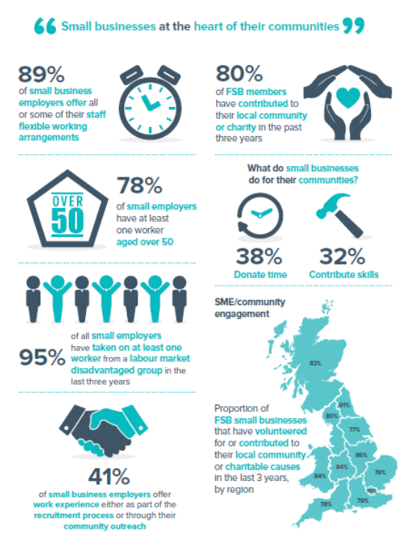
SMALL BUSINESS, BIG HEART

Slide 4
What does our research show?
Small business impact is not just purely economic but the wider contribution is difficult to quantify
Small businesses are not ‘little big firms’ and therefore their approach to social responsibility is distinct from the more familiar large firm Corporate Social Responsibility (CSR) approach
Small businesses seek to engage, act and transform, not specifically to promote their efforts
A business owner’s decision to engage with their community is often made on the basis of personal convictions

Slide 5
Community Engagement
80 per cent of FSB members have volunteered and/or contributed to a local community organisation or charitable cause in the last three years. Of those that have, the most common ways to contribute are by donating their time (38%) and providing skills, resources and mentoring (32%).
27 per cent of FSB small businesses hold a position within their local community.
42 per cent of small businesses engage with schools, colleges and youth organisations.
41 per cent of small business employers offer work experience either as part of the recruitment process or through their community outreach.

Slide 6
Employing labour market disadvantaged groups
95 per cent of FSB small business employers have employed at least one worker from a labour market disadvantaged group in the last three years, some of which include those:
Aged 16-24 (58%)
Aged 50 or above (78%)
With a known disability or mental health condition (30%)
With low levels of educational attainment (34%)
With English as a second language (24%)
Labour market returners (23%)

Slide 7
Good Work and flexible working
89 per cent of FSB small business employers offer all or some of their staff flexible working arrangements, including:
– Flexi-time or staggered working (63%)
– Reduced working hours (61%)
Of those that have flexible working, 71 per cent recognise the benefits this has had, including:
– Reduction of staff absences (44%)
– Creation of new business processes (44%)
– Additional business cost savings (39%)
Of those that offer flexible working, 36 per cent say that providing staff with greater autonomy led to the creation and/or development of a new product.

Slide 8
What do we want to see?
Government deepen its understanding of social impact of small businesses beyond economic
Policy makers must ensure they fully consider the indirect opportunity costs associated with any additional administrative burdens
Ensure there is a small business champion in delivering place based strategies to bring local voice
Explore potential of Community Zones to support smaller businesses outside urban centres and business hubs
Ensure that wider societal impact is recognised in commissioning and procurement
Make it easier for small businesses to contribute

Slide 9
Any Questions?

